Slide 1
Chapter 24
Measuring GDP
Notes:
Instructor: This chapter marks the point of the book where we start delving into important macroeconomic concepts, including gross domestic product and consumer prices. A study of macroeconomics allows us to better understand how well off we will be in the future. This depends on individual choices, like where to live, whether to have a family, and career path decisions. However, this is also largely influenced by forces outside of an individual’s control, such as the availability of jobs, housing prices, and changes in prices over time. The study of macroeconomics allows us to understand how billions of individual decisions add up to shape the economy as a whole. Macroeconomics includes the study of growth, inflation, cycles (booms/busts), and unemployment. This chapter will cover the most useful metric of macroeconomics, gross domestic product (GDP). GDP sums up the economic activity in a country and is used to track overall economic growth and cycles in the economy.

Slide 2
What will you learn in this chapter?
How to calculate gross domestic product (GDP).
Why each component of GDP is important.
What different approaches are used to calculate GDP.
What the difference is between real and nominal GDP.
How to calculate the GDP deflator, GDP per capita, and the real GDP annual growth rate.
What limitations of GDP exist.

Slide 3
Valuing an economy I
Macroeconomics is the study of the economy on a broad scale, focusing on issues such as economic growth, unemployment, and inflation.
Macroeconomics helps answer:
  How big is an economy?
  How do we know one country’s economy is larger than some countries but smaller than others?
  What does it mean when a country’s economy doubles in size?
Notes:
In contrast to microeconomics, which studies how an individual person or firm manage their resources, macroeconomics focuses on consumption, production, and prices on an aggregate (often national) level. While a student’s individual decisions might seem to have little influence on the whole economy, macroeconomic issues can have large impacts on their daily lives. For example, people are better off when there is steady economic growth, stable prices, and low unemployment. In contrast, people are worse off when there are periods of stagnation, inflation, and high unemployment. For example, the Chinese economy has recently experienced very large growth.
GDP:
Helps give us a sense of the well-being of the average person in a country.
Indicates the direction of an economy.
Is used to evaluate changes in an economy over time.

Slide 4
Valuing an economy II
Macroeconomics is one measure on the size and value of a national economy.
Gross domestic product (GDP) is the sum of the market values of all final goods and services produced in a country within a given period of time.
GDP is the most common metric for measuring the value of a national economy.

Slide 5
Unpacking the definition of GDP
Gross domestic product (GDP) is the sum of the market value of all final goods and services produced within a country in a given period of time.
  Market value: Used so there are common units to add up goods and services.
  Final goods and services: Only count expenditures on goods and services sold to the consumer.
  Produced within a country: Goods and services are counted towards GDP in terms of location of production.
  Given period of time: Usually refers to an annual estimate.
Notes:
Market value:
Not useful to list detailed output of every good and service produced in an economy (2 units of X, 1 unit of Y, 3 units of Z...)
Also, not useful in comparing economies that produce different products
So… market value is used to establish a common unit to add up all of the goods and services.
Final goods and services:
If we counted all of the intermediate steps, GDP could be increased by trading the same good over and over again and adding up the “transaction.”
Adding up all the transactions associated with getting peanut butter to a consumer — peanut farmer → wholesaler → peanut butter factory → grocery store.
If we added up all the intermediate steps before the purchase price at the grocery store, the peanut butter would contribute more to GDP than the final selling price.
- Unique goods and services: Adding up apples, oranges, roller coaster rides, and haircuts can be difficult unless each has a relative importance to the other. Not double counting intermediate goods: Peanuts that enter into peanut butter. Peanut butter that enters into school lunches.
Produced within a country:
If a U.S. company owns a factory in Mexico, the value of the goods produced in that factory will count towards Mexican GDP, not U.S. GDP
U.S. citizens working in other countries contribute towards that country’s GDP, not the U.S. GDP.
Gross national product (GNP) can be used to measure the value of what is produced by U.S.-owned resources, regardless of location.
Given period of time:
GDP can be measured over any period of time — day, month, year, etc.
Annual figure is most common, but a year is a long time to wait for an update on the economy. GDP is usually calculated on a quarterly basis.
Note that it is uncommon for an economy to continue at a consistent pace all year, so it is common to use seasonally adjusted estimates.
December usually has more economic activity because of travel and purchases of holiday gifts.

Slide 6
Production = expenditure = income
The size of an economy is referred to as either output or production.
Circular Flow Diagram
Total output can be measured as total income.
Total output can also be measured as total expenditures.
Value of Production = Expenditure = Income
Land, labor,
Households
Goods and
and capital
services
bought
Income
Spending
Markets for the
Markets for goods
factors of production
and services
Wages, rent,
Revenue
and profit
Purchased
Goods and
land, labor,
services to
and capital
Firms
be sold
Flow of dollars
Flow of goods
and services
Notes:
Note that output or production includes both goods and services. In fact, ¾ of U.S. output is services, not goods.
On the circular flow diagram:
Land, labor, capital, and goods flow from households to firms through the factors markets.
Goods and services flow from firms to households through the goods and services markets.
Note that in each transaction, expenditures by one party are income to another.
Emphasize that we get the same figure for GDP whether we measure expenditure or income in an economy.
Production = expenditure = income holds only if we lived in a closed economy where everything is produced and sold domestically and consumed as soon as it’s produced. However, the actual economy is a bit more complicated. The existence of international trade means the economy is not closed; items that are kept in inventory are not consumed as soon as they are produced.

Slide 7
Measuring GDP: The expenditure approach
The expenditure approach sums up the four categories of expenditures to calculate total expenditures (Y):
Y = C + I + G + NX
Consumption (C) is spending on goods and services by private individuals and households.
Investment (I) is spending on productive inputs, such as factories, machinery, and inventory changes.
  Inventory is the stock of goods that a company produces now but does not sell immediately.
Government purchases (G) is spending on goods and services by all levels of the government.
Net exports (NX) is exports minus imports.
Notes:
Consumption: Goods and services bought by individuals and households with the intent of consuming them. This includes most of the goods and services that you buy for yourself. Note that these must be new items. Something that is purchased used on eBay is not included in current GDP (as it was already counted when it was first produced and sold). However, the transaction fee and the payment for delivery is included in GDP. Examples of consumption include groceries, clothing, computers, tutoring, plumbing, and college tuition.
Investment: Items that are bought by people of firms that are to be used in producing other goods and services. Note that investment includes buildings and other structures that are involved in providing goods and services. Like consumption, these must be new items. For example, a newly built house is investment, but renting a place to live is consumption (think of it as “consuming a place to live”). Examples of investment include a farmer buying a new tractor, a clothing factory buying a new machine for the assembly line, a mechanic building a new warehouse to service cars, and a housing company building new lakeside condominiums. Contrast this type of investment to financial “investments” like stocks, bonds, and mutual funds. These are not included in investment because (1) when you buy, the money is not given to the company but instead to another investor who has decided to sell and (2) if they were included, simply buying and selling could increase GDP and therefore make it seem like the economy is growing even though the same number of shares are just trading hands.
Inventory: Goods that are produced but held to be sold at a future time. Note that when these items are sold, their value is subtracted from inventory and added to consumption. These transactions cancel, so the purchase does not increase GDP. Examples of inventory include Ford manufacturing a car today that sits on the lot to be sold next year, and Apple producing 100 new iPads but storing them in a warehouse until the product’s release date. These items become part of the company’s inventory.
Government purchases: Includes both “consumption-type” purchases (e.g., new bulbs for street lights), services (e.g., paying for labor to fix city streets), and “investment-type” purchases (e.g., buying a truck for government workers to use to fix city streets). It is important to note that transfers are not counted as part of government purchases. Transfers refers to spending that transfers resources between individuals (e.g., Social Security).
Net exports: We want to count all goods and services produced in the U.S. regardless of whether they are consumed in the U.S. or in another country. If they are consumed in the U.S., they will already be a part of consumption, investment, or government purchases. Items produced in the U.S. and consumed by citizens of another country are exports and should be included in GDP. However, we don’t want to count goods produced in other countries that U.S. citizens consume (imports). So, we add the net difference between the two (exports - imports) to our GDP calculation.

Slide 8
Imports and Exports
Goods produced domestically add to GDP, regardless whether purchased for C, I, G, or by foreigners (exports).
Goods produced abroad but consumed domestically (imports) are subtracted from GDP.
C + I + G
Exports
(added in)
GDP
Imports
(subtracted out)
Notes:
Transactions between foreign producers and foreign buyers do not involve domestic production or expenditure and therefore do not figure into GDP calculations.

Slide 9
Summing spending categories I
The U.S. GDP for 2018 is broken down as follows.
Trillions of dollars ($)
20
18
Consumption is by far the largest single category of expenditure.
U.S. residents buy more goods from other countries than they sell, NX < 0.
Expenditure = C + I + G + NX = Production.
Government purchases (17.2%)
16
14
Investment (18%)
12
10
8
6
Consumption (68% of total GDP)
4
2
0
Net exports (-3.2%)

Slide 10
Summing spending categories II
This table categorizes situations according to the expenditure approach.
Situation | GDP Category | Why?
Buying a new digital camera | Consumption | Purchasing a new good or service always counts toward GDP.
Buying a used camera on eBay | Not counted | As a used good, the camera does not count toward GDP, as it was already counted when new. The fees paid to eBay for selling the camera count as consumption, though.
Buying a new house | Investment | Since the house buying a house will provide a place to live for years into the future,, it makes sense to think of it as an investment.
Renting an apartment | Consumption | You are paying the owner of the house for a service, so it is counted as consumption.
Apple makes a new batch of iPhones but doesn’t sell them until next year | Investment | Counted as part of investment, as Apple is holding these tablets as part of its inventory.
Buying shares of General Motors stock | Not counted | Shares of stock are a transfer of money from one owner of the stock to another. Including stocks would cause a double-counting problem.
TSA buys plastic bins for airport security | Government spending | Any consumption or investment purchases made by the government are counted in GDP as government spending.
Babysitting for your neighbor | Not counted | In principle, it should be included in GDP, but such income is often not reported to the IRS so it can’t be included in official statistics.

Slide 11
Active Learning: Expenditure approach
For each of the following scenarios, categorize each GDP spending item using the expenditure approach.
Delta purchases an airplane built in Canada.
DELL builds a new computer. At the end of the year, the computer is not sold and is placed in storage.
The government pays a U.S. company for a new naval missile carrier.
Joe purchases Pearl Jam tickets in Denver, CO.
Sarah purchases a new VW car manufactured in Germany.
The government pays $100 million to war veterans.

Slide 12
Active Learning Solution I
For each of the following scenarios, categorize each GDP spending item using the expenditure approach.
Investment, Import
Delta purchases an airplane built in Canada.
DELL builds a new computer. At the end of the year, the computer is not sold and is placed in storage.
The government pays a U.S. company for a new naval missile carrier.
Joe purchases Pearl Jam tickets in Denver, CO.
Sarah purchases a new VW car manufactured in Germany.
The government pays $100 million to war veterans.
Investment, Inventory
Government expenditure
Consumption
Consumption, Import
Transfer,
not counted

Slide 13
The income approach
The income approach adds up the income earned by everyone (households and firms) in a country. Includes:
  wages earned by workers
  interest earned on capital investments
  rents earned on land
  profits earned by firms.
  Y= Income = Wages + Interest + Rental income + Profits
Notes:
When goods produced in the United States are exported, the transaction is expenditure by other countries and income for the United States. When people in the United States spend money on goods made in another country, the transaction is expenditure in the United States and income for the other country.

Slide 14
The “value-added” approach I
The value-added approach calculates the value that each transaction adds to the economy.
This allows us to determine how much of the total amount paid was created at each step in the production process.
This approach is helpful in avoiding double-counting and calculating how the resale of existing goods contributes to GDP.
The value-added, expenditure, and income approaches all yield the same calculation of GDP.
Notes:
Sums up the value added at each stage of the production process. Example: Peanut butter
Peanut farmer adds value combining seeds, land, and water to grow peanuts. The farmer sells the peanuts to a wholesaler who sells the peanuts to a factory. The factory sells peanut butter jars to a grocery store who sells the final product to the consumer.
Subtract the amount paid at each stage from the amount paid in the previous stage → this is the value added for each stage. Sum each of these up to determine the final value added. This will be the same amount as if the other methods were used.
Expenditure vs. income vs. value-added:
Expenditure — Separates different types of expenditures (e.g., how much more do consumers contribute to GDP than the government?).
Income — Provides information about the relative importance of different factors of production.
Value-added — Identifies the value associated with each production stage.
Explain that many countries use all three approaches to provide policy-makers and researchers a full picture of the country’s economic activity.

Slide 15
The “value-added” approach II
Let’s calculate the value added of peanut butter.
A farmer grows peanuts and sells them to a wholesaler for $0.12, adding value of $0.12 to the economy.
A wholesaler sells them to a peanut butter factory for $0.25, adding value of $0.13 = $0.25 - $0.12.
A factory sells jars of peanut butter to a grocery for $1.85, adding value of $1.60 = $1.85 - $0.25).
A grocery store sells jars of peanut butter to consumers for $3.40, adding value of $1.55 = $3.40 - $1.60.
Final valued-added is:
$0.12 + $0.13 + $1.60 + $1.55 = $3.40

Slide 16
Active Learning: The “value-added” approach
Suppose that a pair of pants has the following production process. Provide the value added at each process and the value of a pair of pants in GDP.
Situation | Value of Output
Cotton | $2
Denim Fabric | $6
Jean Producer | $9
Jena Distributor | $10
Jean Retailer | $23
Value-added:
  Cotton:_______
  Denim Fabric: _______
  Jean Producer: _______
  Jean Distributor: _______
  Jena Retailer: _______
What is the sum of the values added from all production processes to make the shirt?

Slide 17
Active Learning Solution II
Suppose that a pair of pants has the following production process. Provide the value added at each process and the value of a pair of pants in GDP.
Situation | Value of Output
Cotton | $2
Denim Fabric | $6
Jean Producer | $9
Jena Distributor | $10
Jean Retailer | $23
Value-added:
  Cotton: $2
  Denim Fabric: $4
  Jean Producer: $3
  Jean Distributor: $1
  Jena Retailer: $13
What is the sum of the values added from all production processes to make the shirt?
$2 + $4 + $3 + $1 + $13
= $23
Notes:
Note that adding up all the value added amounts from each production stage yields the same answer as the price of the final good.

Slide 18
Using GDP to compare economies I
U.S. GDP increased from $12.5 trillion in 2005 to nearly $21 trillion in 2018.
Does this mean that people in the U.S. produced more goods and services in 2018 as compared to 2005?
GDP is a function of both the quantity of goods and services produced (output) and their market value (prices).
Often an increase in GDP is the result of growth in both quantity and market value.

Slide 19
Using GDP to compare economies II
In order to use GDP to compare economic growth over time or different economies to one another, we need to know how much of the growth is attributable to each factor.
  Nominal GDP: Goods and services are valued at current prices.
  Real GDP: Goods and services are valued at constant prices.

Slide 20
Nominal versus real GDP
To calculate nominal GDP:
  Multiply the quantity of each good in a given year by its price in that year.
To calculate real GDP:
  Select a base year to fix prices.
  Multiply the quantity of each good in a given year by its base year price.
Year
Pizza
Price of
Spaghetti
Price of
Nominal
Real GDP
What’s happening
(millions)
Pizza ($)
(millions)
Spaghetti ($)
GDP
in 2010 prices
(millions of $)
(millions of $)
2015
(5
x
$10)
+
(5
x
$10)
+
I
n
t
h
e
b
a
s
e
y
e
a
r
,
(base year)
5
10
20
8
(20
x
$8)
=
(20
x
$8)
=
nominal GDP and
$210
$210
real GDP are equal
by definition.
(6
x
$10)
+
(6
x
$10)
W
h
e
n
o
u
t
p
u
t
r
i
s
e
s
2016
6
10
22
8
(22
x
$8)
=
(22
x
$8)
+
and prices stay
=
constant, nominal
$236
$236
and real GDP rise at
the same rate.
(6
x
$12)
+
(6
x
$10)
W
h
e
n
p
r
i
c
e
s
r
i
s
e
+
and output stays
2017
6
12
22
10
(22
x
$10)
=
(22
x
$8)
=
constant, nominal
$292
$236
GDP rises, but real
GDP does not.
(7
x
$13)
+
(7
x
$10)
When both output
2018
7
12
25
11
(25
x
$11)
=
(25
x
$8)
+
and prices rise,
=
nominal and
$366
$270
real GDP rise at
different rates.
Notes:
Real GDP focuses solely on output, and the constant prices are given for a specific year. Nominal GDP reports GDP without controlling for price changes. The example on this slide shows how many slices of pizza and plates of spaghetti were sold at their respective per unit prices in each year between 2015 and 2018 and the corresponding real and nominal GDP calculations, with an explanation of why the two numbers are different.

Slide 21
Active Learning: Calculating nominal and real GDP
Calculate nominal and real GDP given a base year of 2017.
Year | Quantity of Apples | Quantity of Oranges | Price of Apples ($) | Price of Oranges ($)
2016 | 2 | 5 | 1 | 1
2017 | 3 | 5 | 2 | 1
2018 | 5 | 5 | 3 | 2
Year | NGDP | RGDP
2016
2017
2018

Slide 22
Active Learning Solution III
Calculate nominal and real GDP given a base year of 2017.
Year | Quantity of Apples | Quantity of Oranges | Price of Apples ($) | Price of Oranges ($)
2016 | 2 | 5 | 1 | 1
2017 | 3 | 5 | 2 | 1
2018 | 5 | 5 | 3 | 2
Year | NGDP | RGDP
2016 | 2 × $1 + 5 × $1 = $7 | 2 × $2 + 5 × $1 = $9
2017 | 3 × $2 + 5 × $1 = $11 | 3 × $2 + 5 × $1 = $11
2018 | 5 × $3 + 5 × $2 = $25 | 5 × $2 + 5 × $1 = $15
Notes:
Explain to students that because prices are held constant, real GDP is less than nominal GDP for years with price increases (such as 2018). Nominal GDP equals real GDP in the base year.

Slide 23
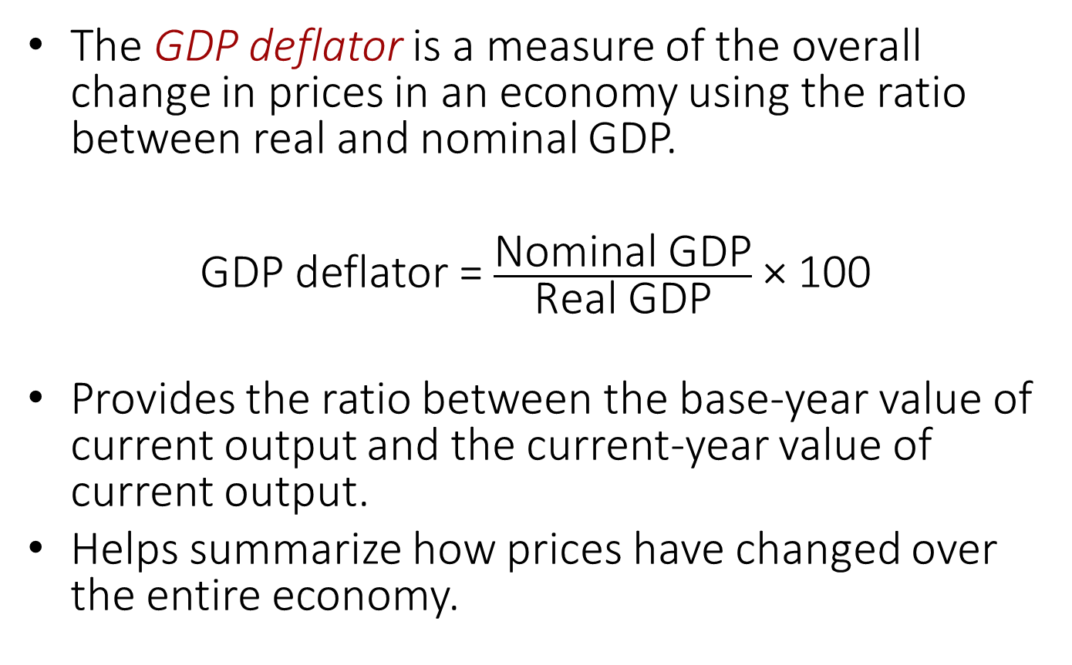
The GDP deflator I
The GDP deflator is a measure of the overall change in prices in an economy using the ratio between real and nominal GDP.
GDP deflator = $\frac{\text{Nominal} \text{GDP}}{\text{Real} \text{GDP}}$ × 100
Provides the ratio between the base-year value of current output and the current-year value of current output.
Helps summarize how prices have changed over the entire economy.
Notes:
The GDP deflator is a weighted average of all of the individual price changes in the economy. We could always directly compare the price of each good in the current and base years, but that would be much like listing every good and service instead of reporting total GDP. Note that in actual governmental statistics, the deflator is calculated with a more complex method (chain-weighted index), but both provide the same basic intuition: a measure of the changes in price levels.

Slide 24
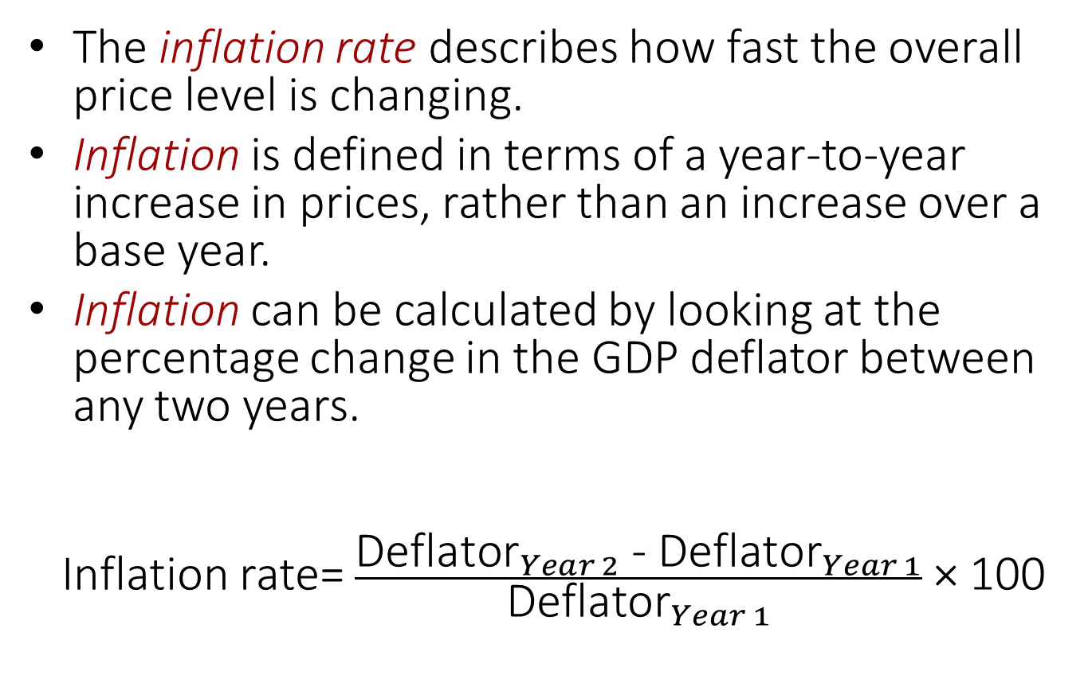
The GDP deflator II
The inflation rate describes how fast the overall price level is changing.
Inflation is defined in terms of a year-to-year increase in prices, rather than an increase over a base year.
Inflation can be calculated by looking at the percentage change in the GDP deflator between any two years.
Inflation rate= $\frac{{\text{Deflator}}_{Year 2}\text{ − }{\text{Deflator}}_{Year 1}}{{\text{Deflator}}_{Year 1}}$ × 100
Notes:
The GDP deflator is one simple way of measuring changes in the price level. It allows us to deflate nominal GDP by controlling for price changes.

Slide 25
The GDP deflator III
Using nominal and real GDP calculations, the GDP deflator and rate of inflation are calculated.
Year
Nominal GDP
Real GDP
Deflator
Inflation
(millions of $)
(millions of $)
2015
210
210
$210
100
×
100
$210
=
—
—
—
2016
236
236
$236
×
100
100
=
(100
0%
-
100)/100
$236
=
2017
292
236
$292
×
100
123
=
(123
23%
-
100)/100
$236
=
2018
366
270
$366
×
100
136
=
(136
123)/123
10.6%
$270
-
=
Notes:
The deflator gets its name from its relationship to inflation, which will be discussed in more detail in future chapters. Use this example to illustrate how students can calculate the deflator [nominal/real × 100] and how students can use the deflator to calculate the inflation rate [(deflator1 - deflator0)/deflator0].

Slide 26
Active Learning: Calculating the GDP deflator
Calculate the GDP deflator for 2016 through 2018.
Year | NGDP | RGDP | GDP Deflator
2016 | $7 | $9
2017 | $11 | $11
2018 | $25 | $15

Slide 27
Active Learning Solution IV
Calculate the GDP deflator for 2016 through 2018.
Year | NGDP | RGDP | GDP Deflator
2016 | $7 | $9 | $7/$9 × 100 = 77.78
2017 | $11 | $11 | $11/$11 × 100 = 100
2018 | $25 | $15 | $25/$15 × 100 = 167
Notes:
Explain to students that the GDP deflator always equals 100 in the base year. Prices increased every year because the GDP deflator increased monotonically each year. The price increase between 2017 and 2018 was larger than the price increase from 2016 to 2017.

Slide 28
Active Learning: Calculating inflation
Calculate the inflation rate for 2017 and 2018.
Year | GDP deflator | Inflation rate
2016 | $77.78 | --
2017 | $100
2018 | $167

Slide 29
Active Learning: Solution V
Calculate the inflation rate for 2017 and 2018.
Year | GDP deflator | Inflation rate
2016 | $77.78 | --
2017 | $100 | ($100 - $77.78) / ($77.8) * 100 = 28.6%
2018 | $167 | ($167 - $100) / ($100) * 100 = 67%

Slide 30
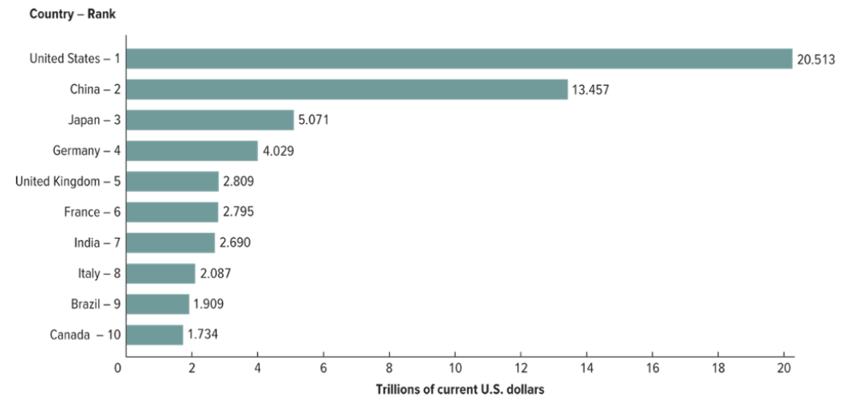
Using GDP to assess economic health
In 2018, GDPs around the world varied substantially.
The U.S. has the largest economy, followed by China.
Does not consider population.
Notes:
This figure shows GDP for a number of countries around the world. We can see that the U.S. had the largest economy followed by China. However, this can be a misleading figure because population levels within these countries are quite different. For example, China’s GDP is around 2/3 as large as the U.S. GDP, but China’s population is more than four times as large as the U.S. On the other hand, Norway has a much smaller economy than the US, but its population is much smaller. In fact, the average Norwegian is actually richer than the average American.

Slide 31
GDP per capita I
GDP per capita is calculated as:
GDP per capita = GDP / population.
Knowing the GDP per capita for different countries suggests a lot about differences in life and well-being between countries.
GDP per capita does not provide information about the distribution of income or the cost of living within a country.
Notes:
GDP per capita gives us an idea of how much is produced per person in a country. Point out to students that while China has a high GDP (refer to previous graph), it has a very high population. So, China would be much lower on the GDP per capita list.
Distribution of income: GDP per capita only provides a measure of the average income per person. So a country with a very high poverty rate but also a very rich elite class could have the same GDP per capita as a country where everyone has a moderate standard of income.
Cost of living: How much can you buy with a given amount of money in each country? Some goods might be more expensive in some countries than others. Also, many poor countries are cheaper to live in than rich ones (cost of living is lower). Without looking at cost of living, poor countries look even poorer than they really are. The U.S. and Netherlands have a similar GDP per capita (around $47,000), but many goods are more expensive in the Netherlands. In other words, a dollar in the Netherlands won’t buy you as much as it would in the U.S. Similarly, it would be almost impossible to live off of $3,000 per year in the U.S., but in parts of Tanzania or Bangladesh, this amount would provide you a decent lifestyle.

Slide 32
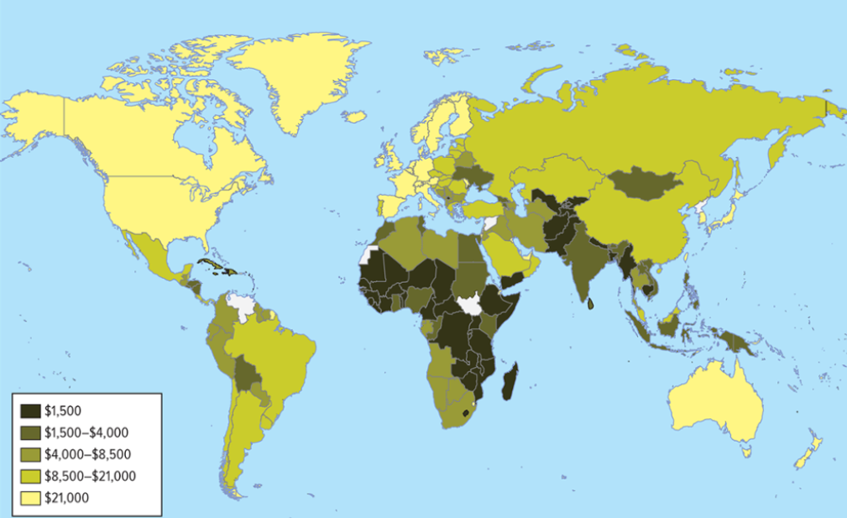
GDP per capita II
GDP per capita around the world varies as well.
Does not consider income inequality.
Does not consider how far a dollar goes in each country.

Slide 33
Active Learning: GDP deflator and GDP per capita
Use the following information to calculate real GDP per capita.
Year | Nominal GDP (millions of $) | Real GDP (millions of $) | Population (millions of people) | Real GDP per capita
2015 | 500 | 400 | 2
2016 | 600 | 450 | 2.25

Slide 34
Active Learning Solution VI
Use the following information to calculate real GDP per capita.
Year | Nominal GDP (millions of $) | Real GDP (millions of $) | Population (millions of people) | Real GDP per capita
2015 | 500 | 400 | 2 | 400/2 = $200
2016 | 600 | 450 | 2.25 | 450/2.25 = $200
Notes:
Even though real GDP and population both increase, real GDP per capita remains unchanged because the population increased at the same rate as real GDP.

Slide 35
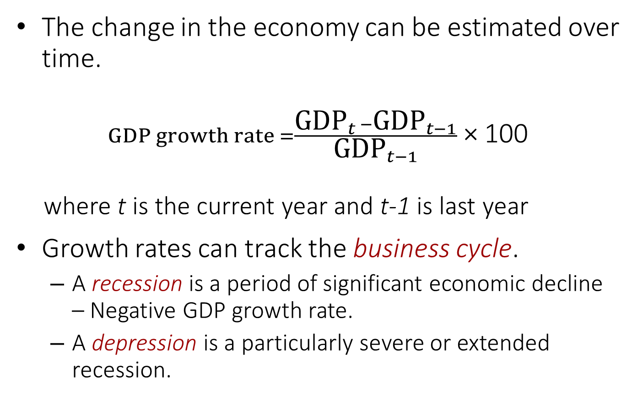
GDP growth rates I
The change in the economy can be estimated over time.
$GDP growth rate =\frac{{\text{GDP}}_{t} −{\text{GDP}}_{t−1}}{{\text{GDP}}_{t−1}}$ × 100
where t is the current year and t-1 is last year
Growth rates can track the business cycle.
  A recession is a period of significant economic decline – Negative GDP growth rate.
  A depression is a particularly severe or extended recession.
Notes:
Growth rate is often measured as the percent change from an annual or quarterly rate. We can use growth rates to compare how fast different countries are growing. But note that high growth rates do not necessarily mean high total GDP.
Recession: No hard-and-fast rule about what “significant decline” means, but it is usually when the economy experiences falling GDP, rising unemployment, and bankruptcies.
Depression: Also no hard-and-fast rule for when a recession turns into a depression.
Recession and depressions are considered “official” when the National Bureau of Economic Research (NBER) calls it.

Slide 36
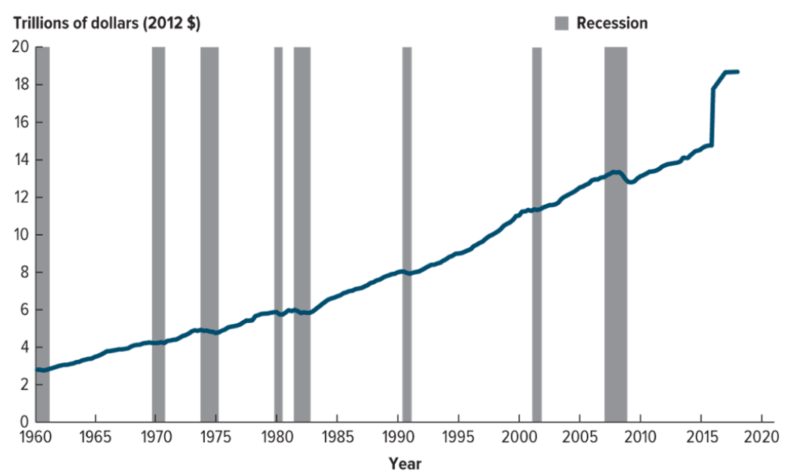
GDP growth rates II
Since 1960, the U.S. had eight periods of recession, even though real GDP grew significantly and steadily over the same period.

Slide 37
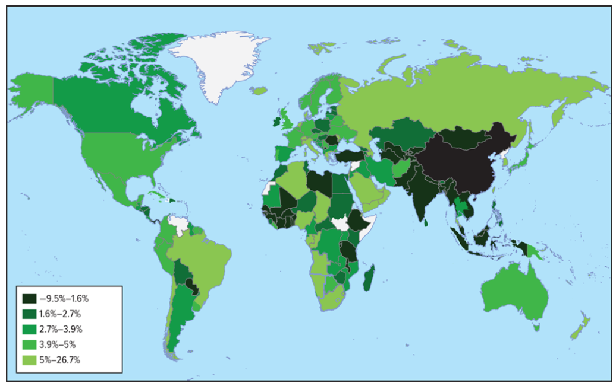
Global GDP per capita
GDP growth around the world.
Growth is more rapid in less developed nations.
High growth rates are not necessarily associated with high total GDP or GDP per capita.

Slide 38
GDP versus well-being
GDP tells much about living standards and can be compared with other measures of well-being.
GDP per capita
Literacy rate
Life expectancy
at birth
Child mortality
Life satisfaction
index
Country
(Current U.S. $)
(% of population
over 15)
(Deaths per 1,000
under age 5)
(Years)
(0 to 10)
Norway
75,505
———
82
3
7.5
United States
59,532
———
79
7
6.9
Equatorial
9,850
95.3
58
92
3.6
Guinea
Brazil
9,821
92.6
74
16
6.6
Bulgaria
8,032
98.4
75
8
4.8
China
8,827
96.4
76
11
5.3
Mali
824.5
38.7
58
110
4.0
Value
(country rank)
Notes:
Emphasize that GDP can tell us a lot about standard of living, but not everything. It’s hard to capture quality of life with any one number, but other metrics, like those listed in the table above, can help give us a fuller picture of a country’s well-being. GDP per capita is usually highly correlated with these quality of life measures, but not perfectly. For example, Equatorial Guinea has a higher GDP per capita than Brazil and Bulgaria, but Brazil has a lower child mortality rate and Bulgaria has a higher literacy rate.

Slide 39
Data challenges
GDP calculations leave out some important types of economic activity.
Green GDP is an alternative measure of GDP that subtracts the environmental costs of production from the positive outputs normally counted.
Home production | The underground economy
Environmental externalities
Notes:
GDP is a powerful start to describing the health and direction of an economy, but we can get a better picture by supplementing it with other measures/metrics.
Home production: Goods and services that are both produced and consumed within one household. For example, if you clean your own house, it’s not included in GDP (even though if you hired a cleaner it would be included). Similarly, making a meal at home is not included (even though going out to eat at a restaurant is).
The underground economy: Goods and services that are sold outside of official records. This includes the transaction of things like drugs, restricted weapons, and endangered animals. (These transactions take place in what is called the black market). Also included in the underground economy are services like mowing your neighbors lawn or babysitting your nephew.
Environmental externalities: The costs associated with pollution are not included in GDP. For example, electricity is part of GDP, but the resulting air pollution from electricity factories is not accounted for as a cost of this action. To incorporate the value of pollution, some calculate green GDP, where environmental costs of production are subtracted. This can greatly change GDP growth rates. For example, China has few regulations against pollution, and 2007 green GDP calculations that adjusted for the pollution caused by some Chinese province’s manufacturing plants resulted in GDP growth rates close to zero.

Slide 40
Summary I
GDP is one of the most commonly used tools in macroeconomics and gives a measure of the size of an economy.
GDP is the sum of the market values of all final goods and services produced within a country in a given period of time.
There are three approaches used to calculate GDP:
  The expenditure approach classifies and adds up spending on all goods and services produced in an economy and subtracts spending on imports.
  The income approach adds up income earned by everyone in a country.
  The value-added approach accounts for the value that is added to the economy at each production stage.

Slide 41
Summary II
Real GDP is calculated based on goods and services valued at constant prices.
Nominal GDP is calculated based on goods and services valued at current prices
GDP per capita allows comparisons over time and across countries.
The overall price level can be calculated using nominal GDP and real GDP, called the GDP deflator.
GDP does not provide the full picture of an economy’s health and quality of life.

